Slide 1

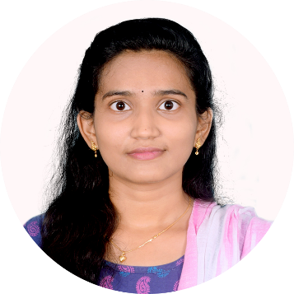





Varshitha Gudimetla
Education and certificates
Bachelor of Technology Electronics and communication : 2017 - 2021
Analyst/Software Engineer
Skills
C#
Basics, OOPS, Generics, Collections, Arrays, Loops.
Base Location: Hyderabad
Email ID:
varshitha.gudimetla@capgemini.com
_{Mobile No: +91 9347088358}
Grade:
A4
Spring REST
REST controllers, Implementation of GET, POST, PUT & DELETE, Validation, Controller.
Strengths
Hands on experience in creating microservices with ASP.NET MVC Entity framework .
Proficient in creating Single page Web Application in DOTNET with Authentication with routing.
Hands on experience in developing web pages using MVC,HTML
Hands on experience in developing Web API using swagger UI and Postman.
Achivement
Employee Management System
Database
SQL database – MySQL
Case study of Employee Management System along with ASP.NET MVC , responsive UI with swagger User Interface.
Web Technologies
HTML5 CSS3
AddOns
Github
Azure AZ-900 Postman
.
Additional Details
Excellent Communication Skills
Team Player
Check out my work on GitHub & Video Profile
Presentation Title | Author | Date © Capgemini 2017. All rights reserved | 1

